Slide 1
Missoula County Operations 2016 Greenhouse Gas Emissions Inventory

Slide 2
Results
Missoula County operations emitted a total of 6,810 MtCO2e in 2016

Slide 3
Metric Ton, 2,200 lbs
Equivalent
MtCO2e
Carbon Dioxide
Notes:
How do you equate CH4 and N20 to CO2? GWP potential value, next slide.

Slide 4
1 metric ton= 2,200 lbs
Missoula County emitted 14,982,000 lbs of CO2e, the weight of ~3,745 cars

Slide 5
Monthly demand of average American household
Produce ~143lbs of poultry
Drive ~2,500 miles in medium-sized car
One metric ton of CO2e…
Produce ~48lbs of pork
Produce ~40lbs of beef

Slide 6
Emissions categorized into following scopes:
Scope 1: All direct emissions from on-site fossil fuel combustion
Scope 2: Indirect emissions from energy generated in one location but used in another
Scope 3: Indirect emissions that occur outside the scope boundary as a result of activities within the boundary
Why do we categorize emissions into scopes?
To get a better idea of where emissions come from, and how easy or difficult it would be to set reduction targets for different scopes. It would be easier, for example, to reduce emissions from scope 1 than it would be from scope 3.

Slide 7
Scope 1:
Use of petroleum-based fuel in vehicle fleets (69%)
Use of natural gas or propane for heating facilities (23%)
Fugitive emissions from water and wastewater treatment facilities (8%)
Scope 2:
Electricity use in buildings (83%)
Electricity use in WWTP (17%)
Electricity use from streetlights (<1%)
Scope 3:
Employee commute (100%)

Slide 10
Buildings and Facilities
2,690 MtCO2e
Top 5/ 56 buildings and facilities

Slide 11
Vehicle Fleet
2,066 MtCO2e
221,499 gallons
Top 5/ 31 vehicle fleets

Slide 12
Employee Commute
1,411 MtCO2e

Slide 13
Water & Wastewater Treatment Facilities
642 MtCO2e
Population Served
Lolo: 2,800
El Mar: 1,243
Lewis & Clark: 105
Sunset West: 98

Slide 14
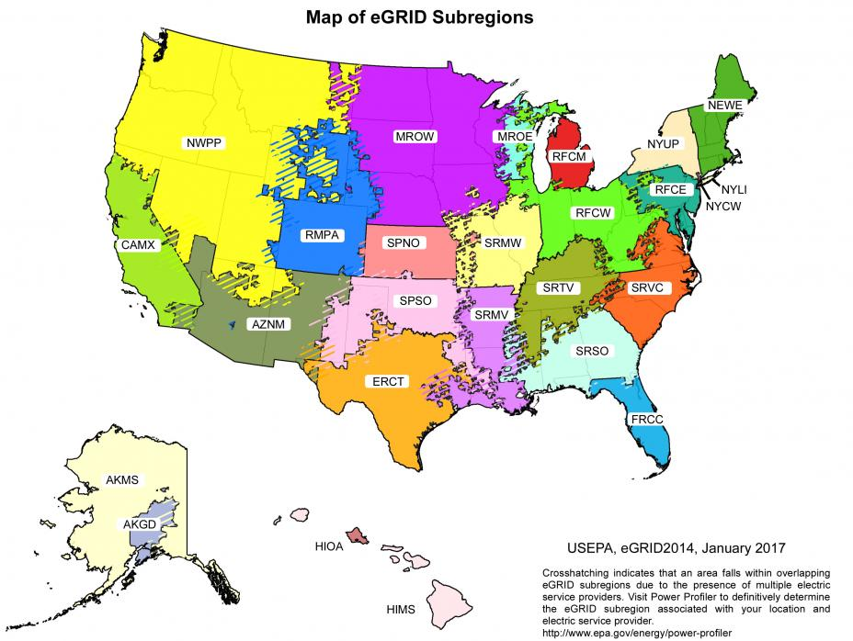
eGRID: Emissions & Generated Resource Integrated Database.
Standard source of emissions data for electricity generated in the U.S.

Slide 15
NWPP Energy mix

Slide 16
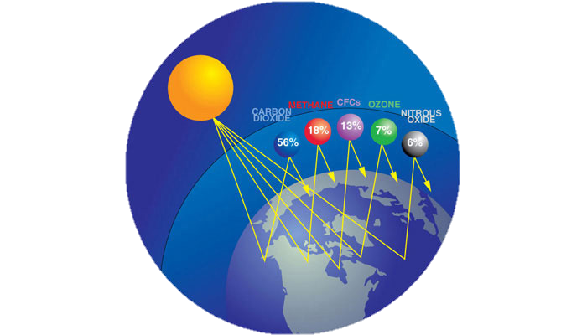
Why measure greenhouse gases?
Growth Policy, Goal 4: Reduce Missoula County’s contribution to climate change while building resiliency
How much is Missoula County contributing to climate change?

Slide 17
How does climate change affect Montana?
In a business-as-usual scenario…
4-5 degree increase by 2055, 6.5 degrees in winter, according to recent report by Montana Wildlife Federation
Less snow, increased rate of runoff, less runoff into streams
Summer droughts, increased wildfire potential

Slide 18
Our changing ecosystems
200-500% increase in acreage burned by 2055
Ponderosa pines, Douglas firs → Spruce-fir
Grasslands → sage, scrubs
Less moisture + higher temperatures= more disease and beetle kill

Slide 19
Increased stream temperatures + decreased water levels due to less snow runoff = decrease in native fish populations
Increase in competition with invasive species more suitable for warmer water environments
Cutthroat trout habitat has declined by 85%, with expected additional 58% decline by 2080

Slide 20
Health impacts
Changes in temperatures and precipitation will have profound impacts on human health and wellbeing:
Increase in wildfires → increase in particulate matter → decrease in air quality → respiratory and cardiovascular illness
Increasing temperatures → decrease in body’s ability to thermoregulate → heat stroke, sometimes death
Increase in CO2 levels and temperatures and altered precipitation → higher pollen concentration and longer pollen seasons → worsened allergy conditions

Slide 21
Impacts on agriculture
Increase in CO2 → plants grow faster and take-up less nitrogen → less plant nutrients (both wheat and plants for livestock)
Decrease in moisture during summer + increase in CO2 → fast growing, dry plants → increase in wildfire → degradation of vegetation for livestock
According to a 2016 report by the Montana Farmers Union, by 2050…
Cattle raising: 20% decline in production
Loss in jobs: 12,167 = $364 million labor earnings
Crops: 25% decline in production
Loss in jobs: 12,457 = $372 million labor earnings

Slide 22
Economic Consequences
Tourism second largest industry in Montana
3.1 million people visit Missoula every year and spend around $310 million, according to the Missoula Economic Partnership
Increased temperatures → shorter winters → less winter tourism; 1/3 decrease by 2050
Loss of 1,500 winter-sport jobs
$37 million in labor earnings
Montana’s outdoor economy could experience a total loss of 11,000 jobs and $281 million

Slide 23
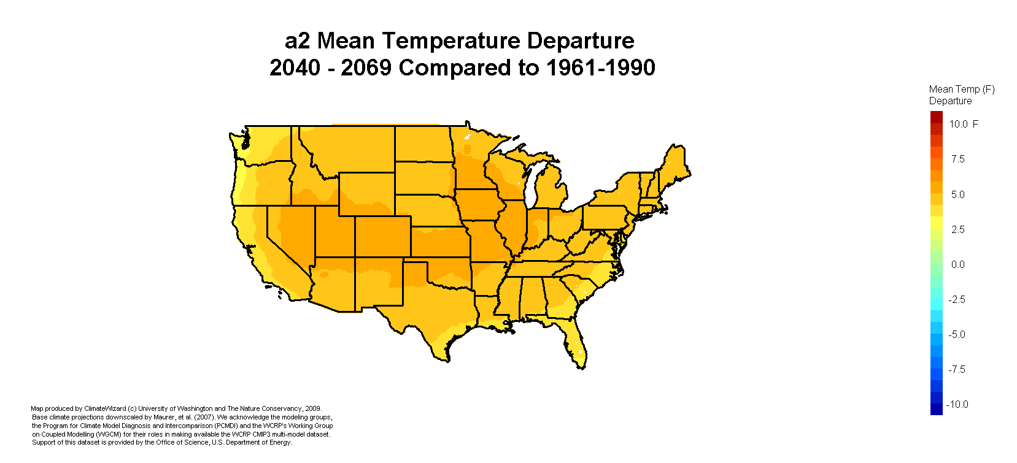
Climate Refugees
People from coastal regions and the South will be likely be seeking refuge in Missoula

Slide 24
Where are we now?
Efforts already made in sustainability:
Waste Reduction and Recycling Policy (Policy No. 2012-04, November 13, 2012)
Green Building Policy (Resolution 2010-070, June 10, 2010)
Motor Pool Vehicle Procurement Policy (Policy No. 2007-04, September 20, 2007)
Disposal of County Surplus Property Policy (Policy No. 2011-02, May 31, 2011)
Addition of Climate Change Provisions in County’s Growth Policy
SITES Certification of Fort Missoula Regional Park (FMRP)
LEED Certification of County Courthouse
Upgrades to Lighting, Heating, Cooling, and Ventilation Systems (HE appliances)
Commitment to Renewable Energy through Community-Oriented Programs
MEC Solar
SolSmart
Habitat Certification of 5 County Parks

Slide 25
Looking ahead
Establish reduction targets
Implement goals in CAP
Monitor Progress
Develop Climate Action Plan
Complete 2016 baseline GHG inventory

Slide 26
Facilities Locator and Emissions map:
http://172.16.33.28/CAPS/MissoulaCountyFacilityLocator/

